Slide 1


BTP
PRESENTATION
CAMPUS PLACEMENTS ONLINE DIGITISATION & AUTOMATION PLATFORM

Slide 2

INTRODUCTION
Our project is a comprehensive Placement Automation Portal designed to facilitate the management of student placements in our college. It serves as a centralized platform where students can register, manage their placement information and access relevant details.
Our project aims to transform the way placements are managed in our college.
With automation and database integration at its core, our portal offers a comprehensive solution to streamline the placement process.

Slide 3



PLACEMENT AUTOMATION MODULES -
Student
Dashboard
Registration form
Data validation
Cross
checking
PHASE 1
Database Integration
Master
Data
Job Notification Form
Expression of Interest

Slide 4

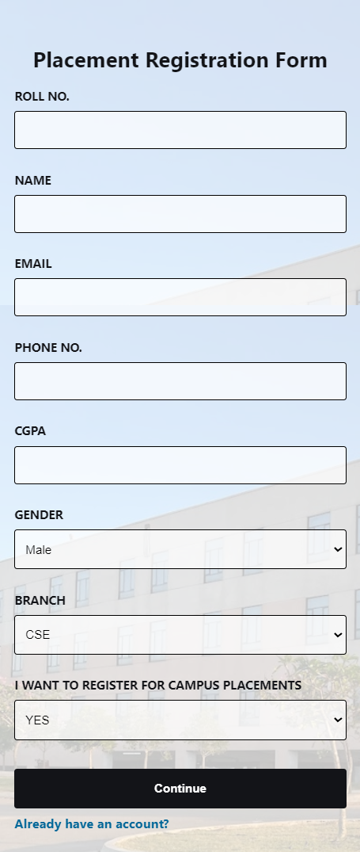

RESGISTRATION FORM
Upon opening the website the registration form appears.
This is the mobile view of the form.
All the fields are to be filled in order for the user to move to the next step.

Slide 5
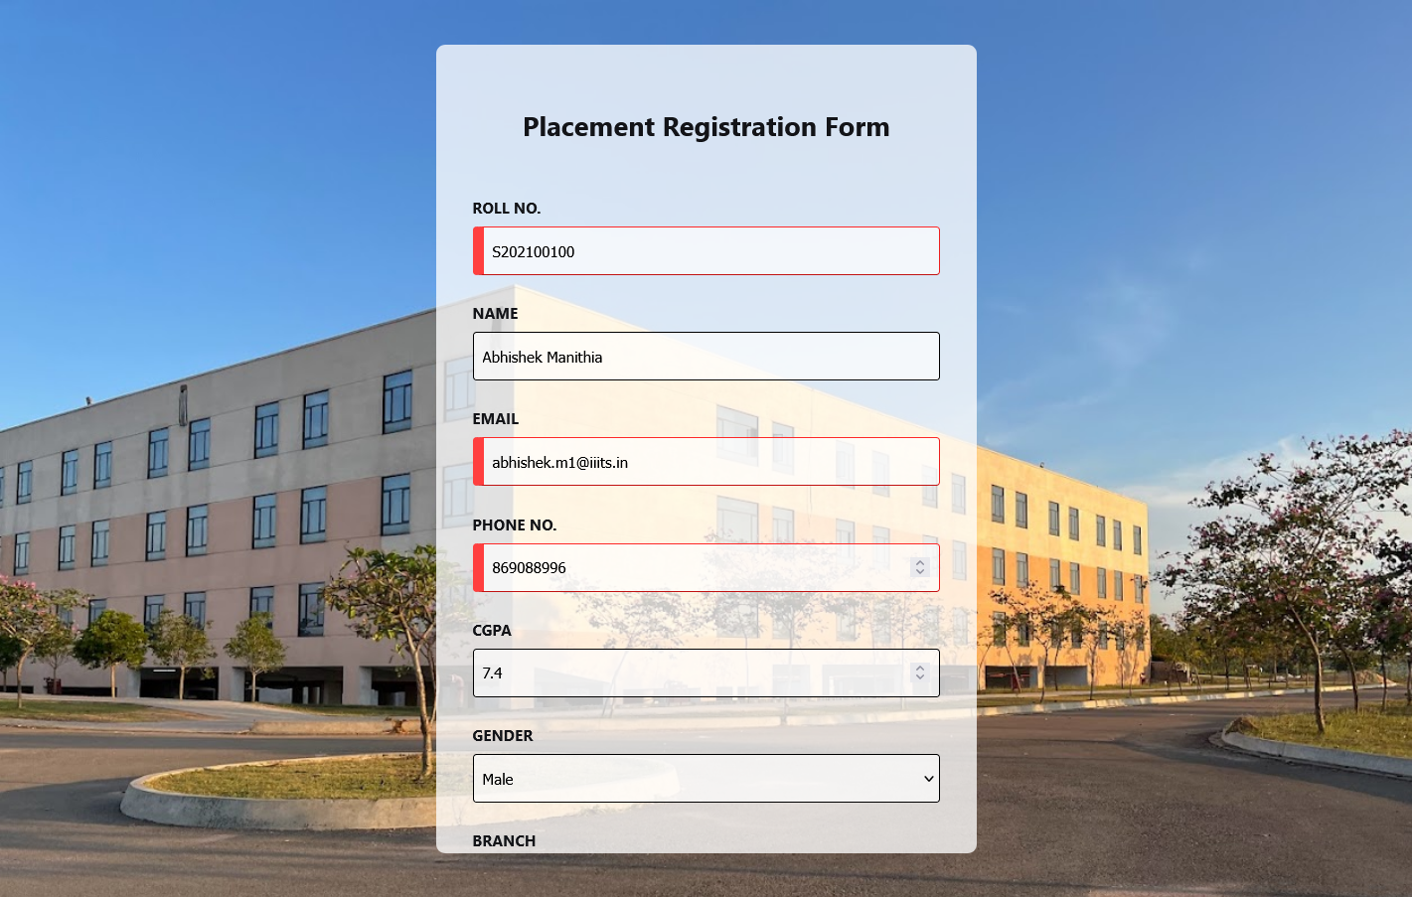
All the fields are validated, So if anything goes wrong, it alerts the user by turning that particular field box red.
User can go to the next step only after all the fields are validated and filled.

Slide 6
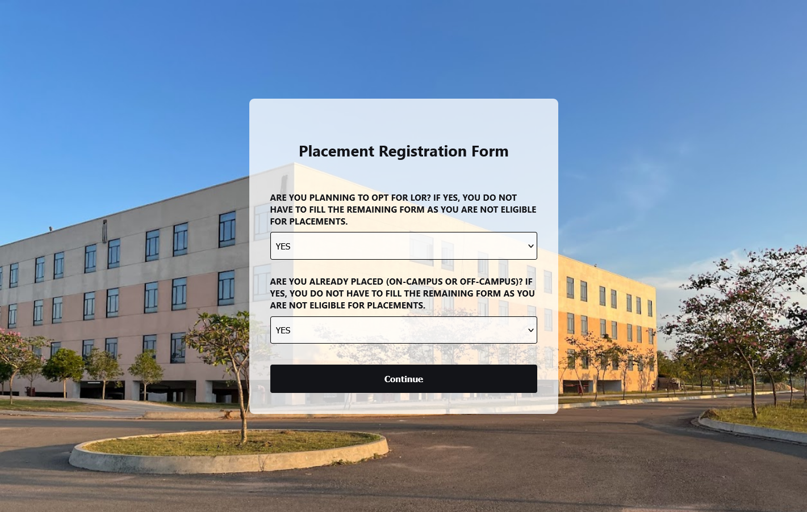
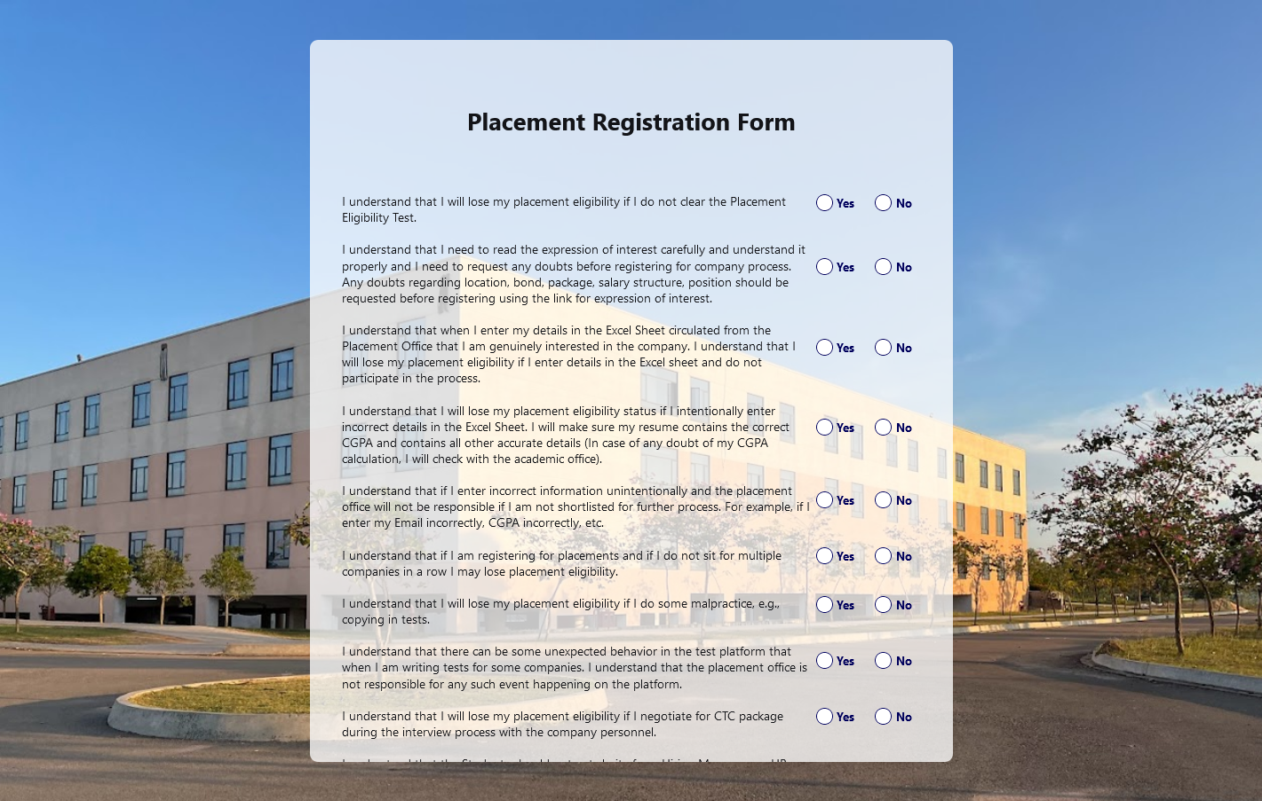
FURTHER FIELDS OF THE FORM

Slide 7


Phase 1 Further Implementation
01
02
03
04
MASTER DATA
STUDENT DASHBOARD
ADMIN DASHBOARD
CROSS CHECKING
Contains all the student’s data.
Student Controls.
Admin Controls.
Cross Checks data from Academic Office.

Slide 8

PLACEMENT PROCESS
Once a company registered for the placement in the college, the complete process will be -
Once the student is selected, the data will be saved in the master database along with the package details.
Students eligible for placement will get the mail and can register for the same using student dashboard
Admin will add processes Ex. coding round 1 along with time and venue if offline which will be sent to the student automatically.
SELECTED
REGISTRATION
PLACEMENT PROCESS

Slide 9

TEAM MEMBERS
Abhishek - S20210010004
Rishabh - S20210010192
Avinash - S20210010095

